Slide 1
Differential Equations

Slide 2
  Generally real-world differential equations are not directly solvable.
  That's when we use numerical approximations.
  We're going to look at some simple ones to get a better understanding of the differential equations themselves.

Slide 3
  Differential Equations contain the derivatives of unknown functions.
  Given some simple differential equations, we can sometimes guess at the form of the function.
  So we will work backwards – from the solution to the differential equation.

Slide 4
A typical linear equation is the relationship between temperature in Fahrenheit and Celsius.
C = (5/9)(F-32)
Using Octave to plot (C,F) for F=32 to 212:
octave:8> F=32:1:212;
octave:9> plot(F, (5/9)*(F-32))

Slide 5
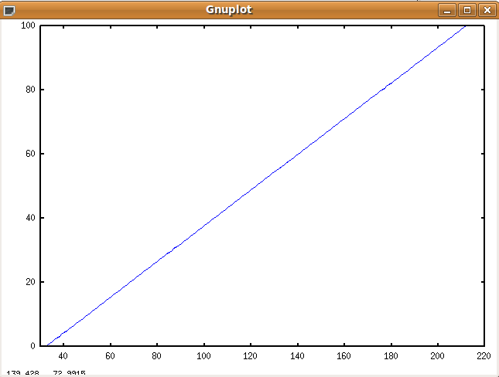

Slide 6
Clearly this function is linear.
If this function was given as a differential equation, it would just be the derivative of C with respect to F. It's a constant function with this initial value:
dC/dF=5/9, C(32)=0
So, if the differential equation is a constant function, the solution is a linear function.

Slide 7
A slightly more complex function.
The position of an object, s, moving at constant acceleration is given by:
s(t)=v₀t+ 1/2at²
Exercise:
  Given an initial velocity of 20 m/s and acceleration of 3 m/s², use Octave to plot this function for t=0 to 10 seconds.
  What is ds/dt? What do you expect that graph to look like?

Slide 8
A little more complex -
The value of the differential equation is dependent on the value of the function?
Let's look at the growth of bacteria.
Bacteria reproduce using binary fission and double in number in each time frame assuming they have enough food. So the change in the number of bacteria is dependent on the number of bacteria already present.

Slide 9
Exercise:
  Assume our example bacteria doubles every ten minutes and has plenty to consume.
  Starting with one bacteria, use Octave to plot the number of bacteria every ten minutes for two hours. How many bacteria are there after two hours?

Slide 10
This function is exponential.
Its general formula is:
x(t)=x₀e^{kt}
where x₀ is the starting value and k is the growth factor.
The differential function that gives us this function is:
dx/dt = kx with x(0)=x₀.

Slide 11
  So testing this out - another population example:
  Population is not often based solely on population growth, but also on predation.
  Assume there is an population of animals, x. They have a growth rate, r, that depends on their birth rate.

Slide 12
What differential equation describes the change in population?
Answer: dx/dt = rx
We recognize this as describing an exponential function. So with no limits, the growth is exponential.

Slide 13
  More realistically, a population is better modeled with two functions:
  For the prey organisms, x, growth is limited by resources. There is a maximum number of organisms, max, that can be maintained in an area. As they approach that number, their growth rate decreases linearly.
  This new information leads us to a new differential equation...

Slide 14
dx/dt=r(1-x/max)
Notice that as x approaches max, dx/dt approaches 0. This function is called the logistic function.
This is its solution:
x(t)=(max*x₀*e^{rt})/(x₀*e^{rt} + max – x₀)
I'll plot this one for you with the parameters:
max = 20, r = 1 and x₀=1.

Slide 15
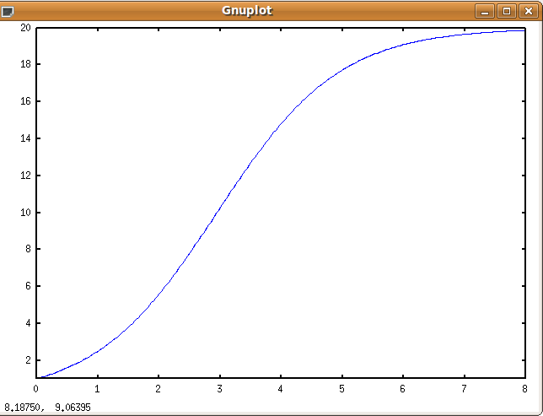
octave:71> t=0:1/32:8;
octave:72> r=1;
octave:73> x0=1;
octave:74> max=20;
octave:75> y = max*x0*exp(r*t)./(x0*exp(r*t)+max-x0);
octave:76> plot(t,y);

Slide 16
  This curve is called an S-curve.
  The function is called the logistic function and also it's called a sigmoid function.
  It shows up in many different models.
  It is frequently used to model biological switching.

Slide 17
  But organisms do not tend to live alone. If they are prey, they live with predators.
  Now the growth of the prey, x, is affected by the number of predators, y. And the growth of the predators is affected by the number of prey.
  Now we have a system of differential equations that depend on each other.

Slide 18
dx/dt = rx - axy
dy/dt = -my + bxy
  r is the growth rate of the prey. If there are no predators, they grow exponentially.
  m is the decay rate of the predators. If there is no prey, they die off.
  Whenever they encounter each other, the prey decrease by a and the predators increase by b.

Slide 19
  We cannot write a formula to express the solution to this system of equations.
  We could use numerical methods to approximate a solution, but we can't find one analytically.

